Slide 1
INTRODUCTION TO RASPBERRY-PI

Slide 2
What is Raspberry-Pi
Credit card size single board computer or a Programmable PC
Developed in U.K. by Raspberry - Pi foundation in 2009
Concept Initiated by Eben Upton who works at Broadcom
Supported by “University of Cambridge Computer Laboratory & Broadcom”
To promote the study of basic computer science in schools & to develop interest among kids and adults

Slide 3
Technical Specifications
System-on-chip used | Broadcom BCM2711
CPU | 1.5 GHz 64/32-bit quad-core ARM Cortex-A72
Memory | 1, 2, or 4 GB LPDDR4-2400 RAM^{[3]}
Storage | MicroSDHC slot
Graphics | Broadcom VideoCore VI 500 MHz^{[4]}
Power | 5V 3A (for full power delivery to USB devices)^{[5]}

Slide 4
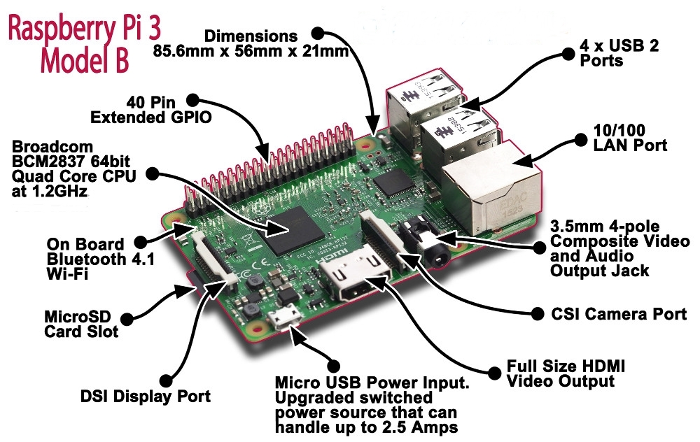
Parts of a raspberry pi

Slide 5
Why is it so popular
Very Low Cost ($25 – Rs 1550/- for Model A & $35 – Rs 2200/- for Model B/B+)
Great tool for Learning Programming, Computers & Concepts of Embedded Linux, etc
Support for all Age Groups (School Children, College Undergraduates, Professional Developers, Programmers)
Supports & runs Free and Open Source Linux OS
Consumes less than 5W of Power
Supports Full HD Video Output (1080p), Multiple USB Ports , etc
Most importantly it has 40 GPIO pins

Slide 6
How to set it up
You’ll need a micro SD card(8Gb or higher )
Go to raspberry pi’s official website and from the downloads page download the latest version of NOOBS
Extract the NOOBS zip file
Format the SD card
Copy the contents of the NOOBS file to the SD card
Insert the SD card in the raspberry pi and power it on
Select the required OS required from the menu and hit install

Slide 7
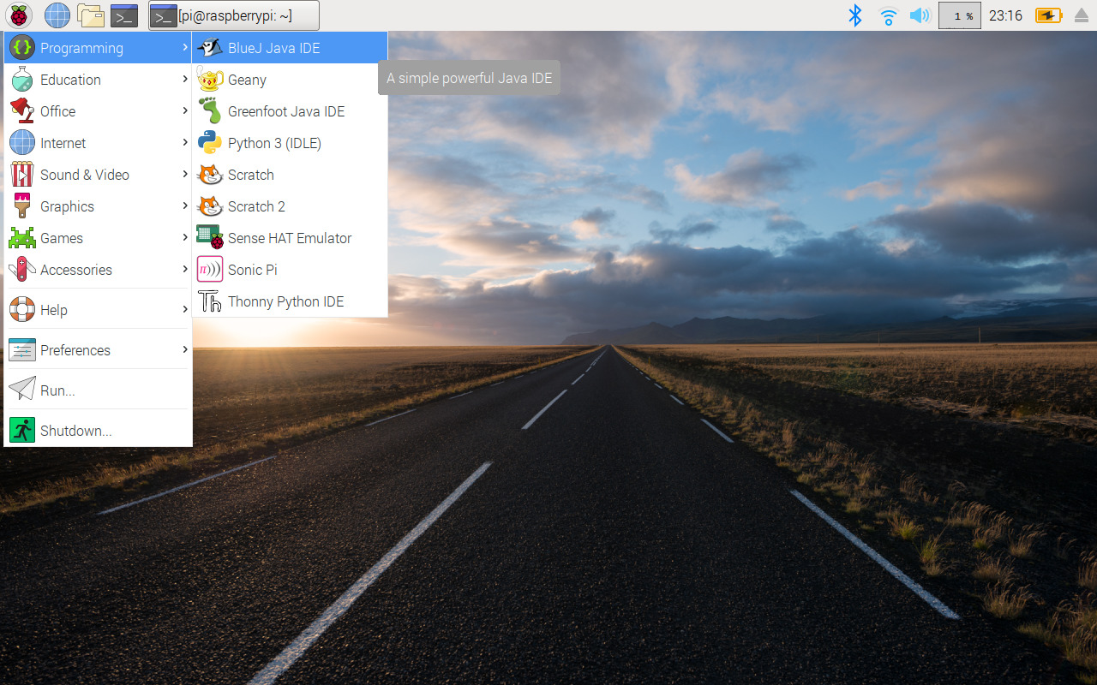
You will get a window like this

Slide 8
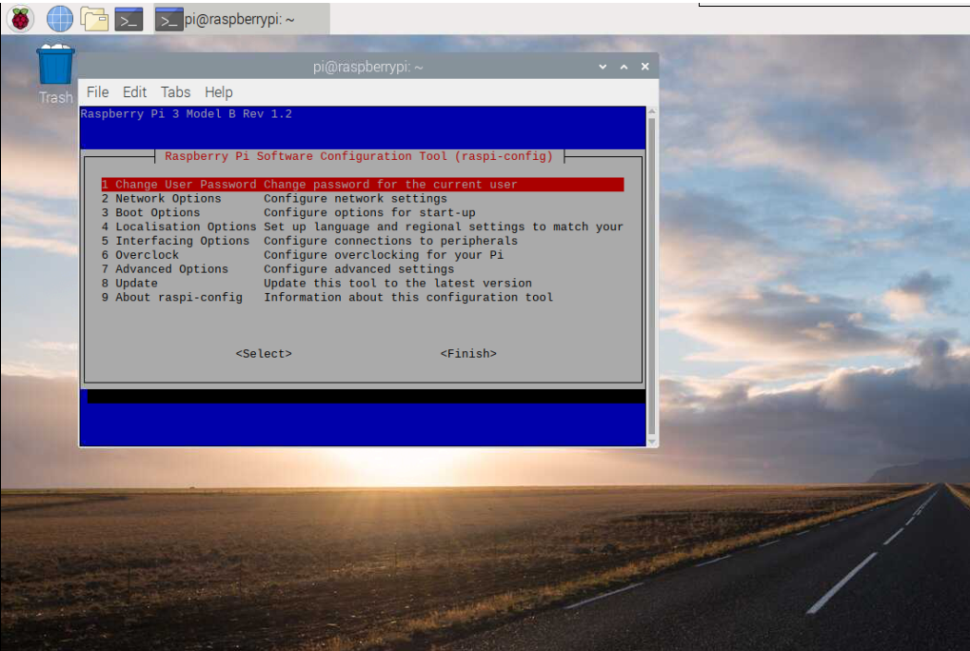
Configuring the Pi for remote access
Press Alt+Ctrl+t to open termminal window
Type sudo raspi-config and press enter

Slide 9
Configuring the Pi for remote access
Go to interfacing options and enable SSH and VNC
Turn on your mobile hotspot and connect both the pi and your laptop to it
Type sudo ifconfig

Slide 10
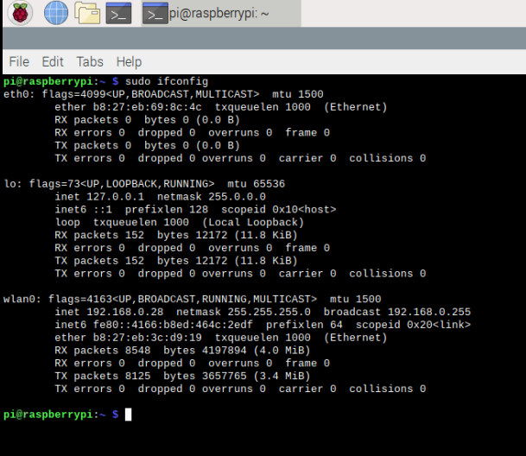
Configuring the Pi for remote access
Save the inet address in wlan0 for later

Slide 11
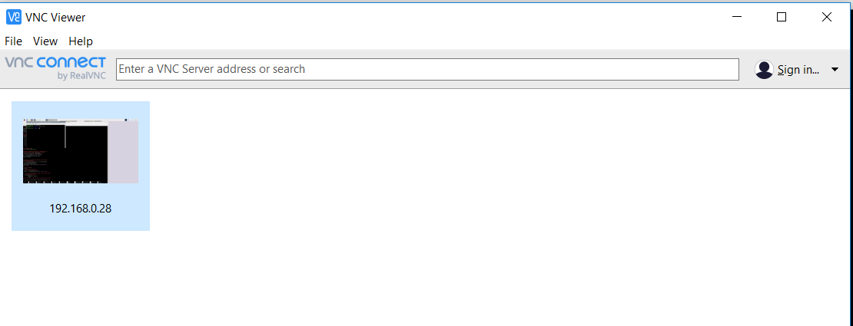
Accessing the Pi via VNC
Enter the ip address in the search bar and enter the required password

Slide 12
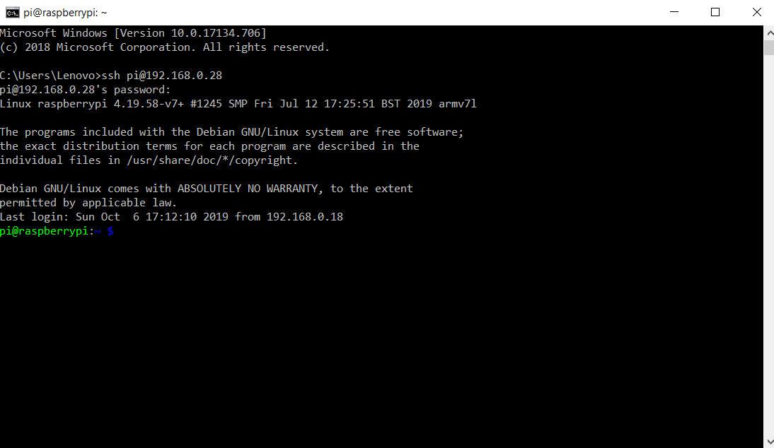
Accessing the Pi via VNC
Open terminal / command prompt on your laptop
Enter ssh pi@”your ip address” and password

Slide 13
Terminal Commands
pwd — When you first open the terminal, you are in the home directory of your user. To know which directory you are in, you can use the “pwd” command.
ls — Use the "ls" command to know what files are in the directory you are in. You can see all the hidden files by using the command “ls -a”.

Slide 14
Terminal Commands
cd — Use the "cd" command to go to a directory.
mkdir — Use the mkdir command when you need to create a folder or a directory.
rm - Use the rm command to delete files and directories.
touch — The touch command is used to create a file. It can be anything, from an empty txt file to an empty zip file.

Slide 15
Terminal Commands
man & --help — To know more about a command and how to use it, use the man command. It shows the manual pages of the command. For example, “man cd” shows the manual pages of the cd command. Typing in the command name and the argument helps it show which ways the command can be used (e.g., cd –help).
cp — Use the cp command to copy files through the command line. It takes two arguments: The first is the location of the file to be copied, the second is where to copy.
mv — Use the mv command to move files through the command line. We can also use the mv command to rename a file. For example, if we want to rename the file “text” to “new”, we can use “mv text new”. It takes the two arguments, just like the cp command.

Slide 16
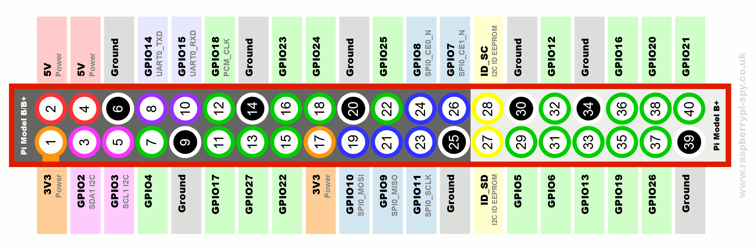
Using GPIO

Slide 17
Using GPIO
In terminal type: sudo apt-get install python-rpi.gpio
touch filename.py
This is used to create a python file
nano filename.py
This is used to open the file with a text editor

Slide 18
Using python to control GPIO
Inside the text editor write the following code
import RPi.GPIO as GPIO
import time
GPIO.setmode(GPIO.BCM)
GPIO.setup(18, GPIO.OUT)
GPIO.output(18, GPIO.HIGH)
time.sleep(3)
GPIO.output(18, GPIO.LOW)
GPIO.cleanup()

Slide 19
Challenge!
Write a python code to make the led blink continuously with on and off time of 1 second

Slide 20
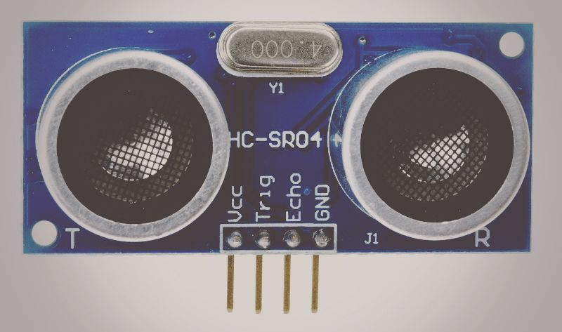
Ultrasonic Sensor

Slide 21
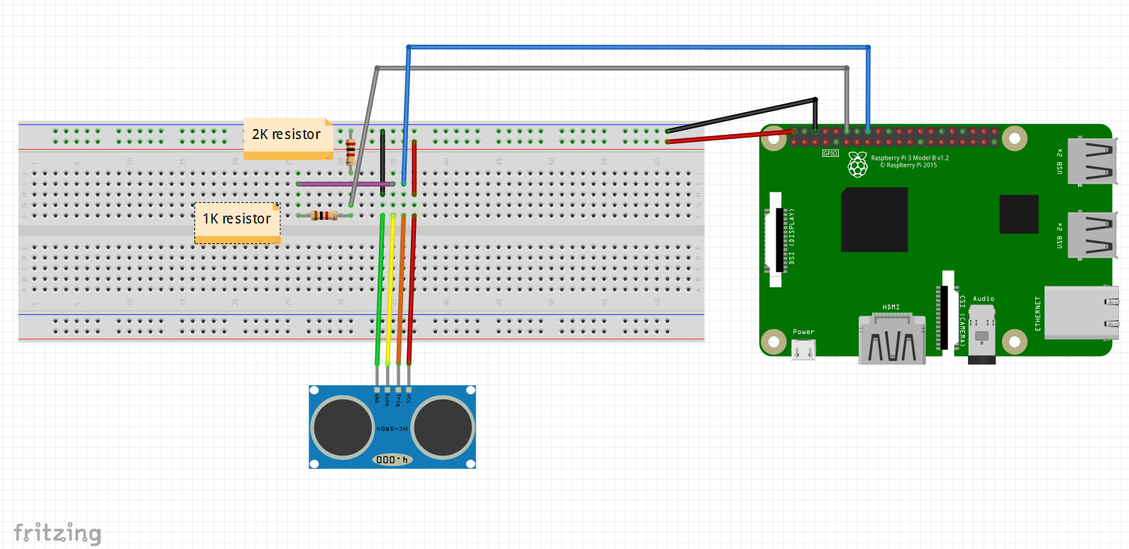
Connection Diagram
Connect GPIO 23 to trig
Connect GPIO 18 to echo

Slide 22
Distance Measurement
After connecting according to the diagram create a new python file
Open it and paste the code from the following page
http://tiny.cc/ultrapi

Slide 23
Endless Possibilities
The ability of the pi to do complex computing tasks along with gpio pins make it very versatile
Since the raspberry pi is a single board computer , you can install different Operating systems for different applications
The only limit is your imagination

Slide 24
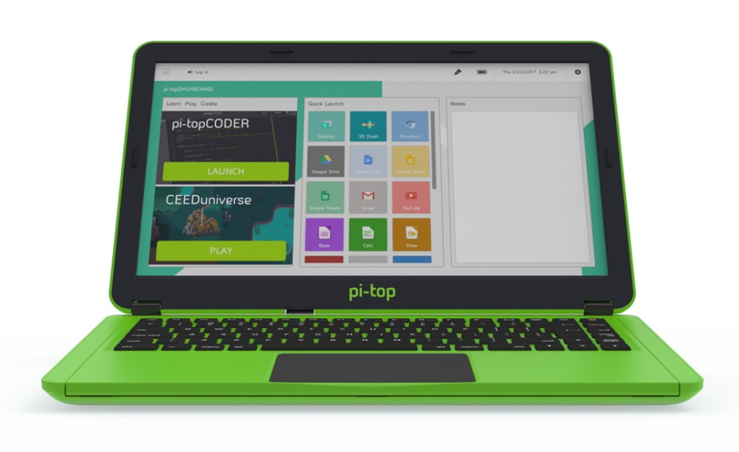
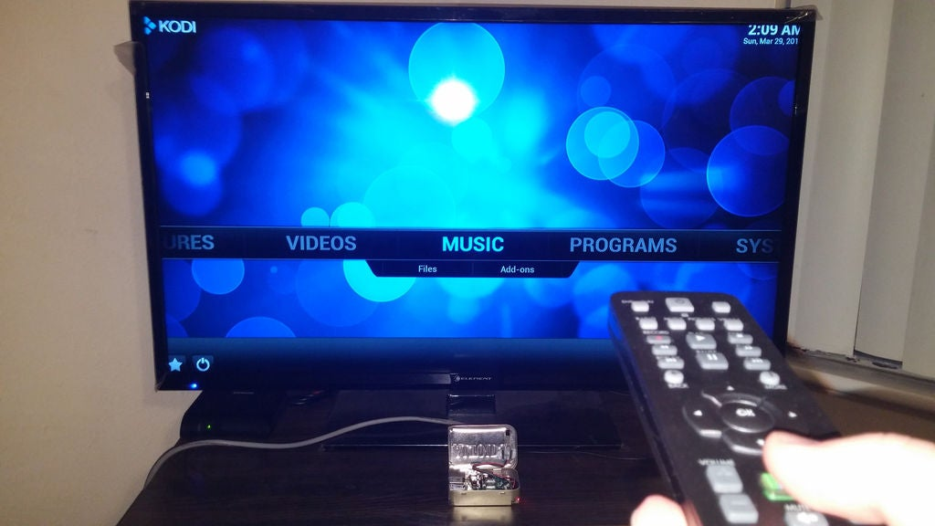
Some Raspberry Pi projects
Pi-pad/Laptop
Media Center

Slide 25
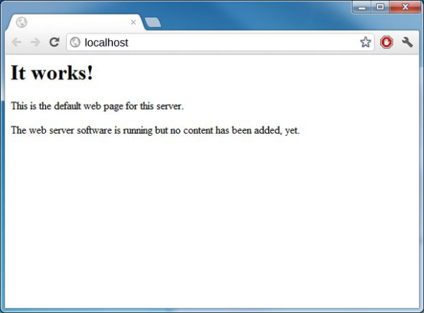
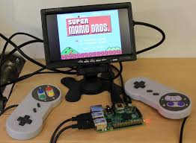
Some Raspberry Pi projects
Webserver
Retro Gaming( Retro-pie)

Slide 26
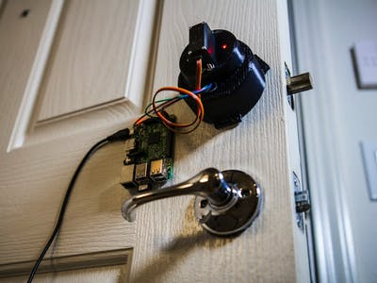
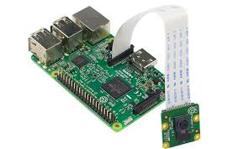
Some Raspberry Pi projects
Low cost Home Surveillance
Home automation

Slide 27
ANY DOUBTS?
Presentation and code used can be found at:
http://tiny.cc/ieeepisession

Slide 28
THANK YOU!

